Slide 1
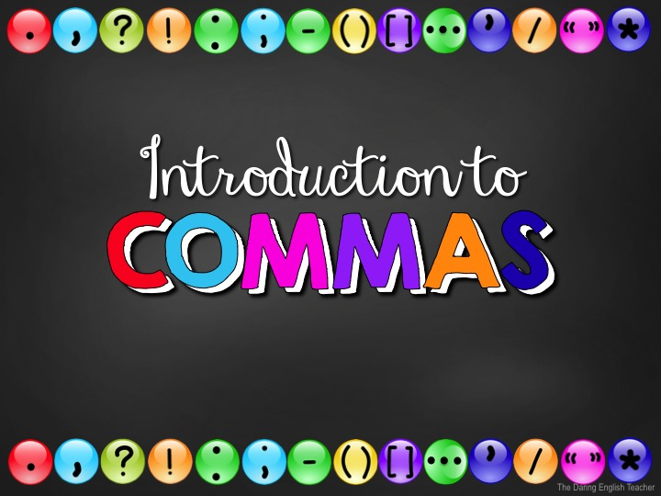

Slide 2
Punctuation
When we talk, we naturally pause and speak with intonation to communicate effectively.
When we write, we need to use punctuation to show these pauses and intonations.

Slide 3
Why Punctuate?
Using punctuation is important because it…
helps your writing flow.
increases the readers’ comprehension.
improves readability.
provides pauses.
conveys messages correctly.
If you punctuate incorrectly, you might write something with an entirely different meaning.

Slide 4
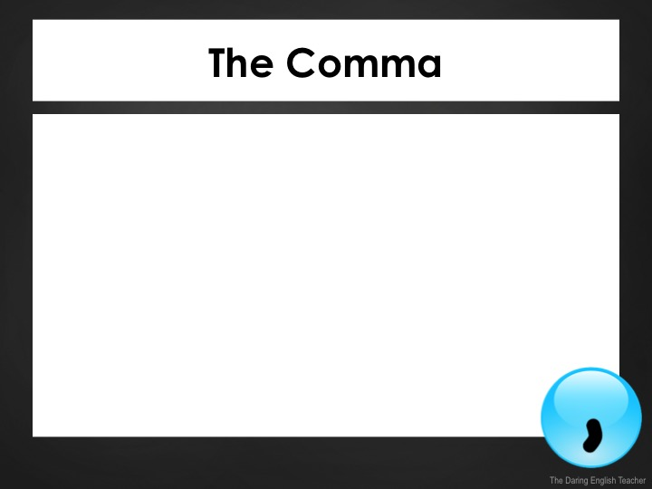
The Comma
The comma is a punctuation mark that indicates a pause between parts of a sentence.
It is also used to…
separate items on a list.
set apart dialogue.
punctuate numerals and dates.

Slide 5
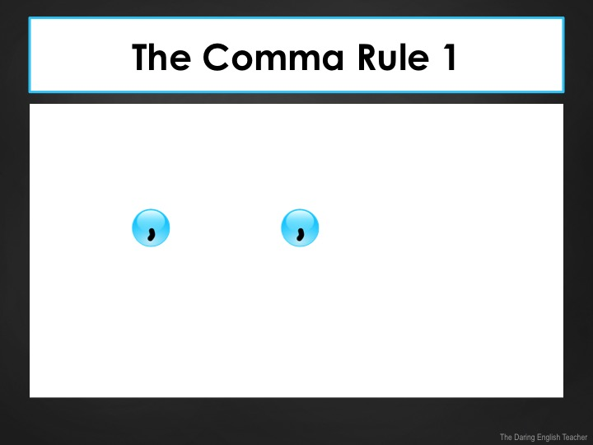
The Comma Rule 1
The comma is used to separate items in a list or series.
Example:
Item + + item + + and + item.
I need to buy shampoo, conditioner, and face wash.
The comma before the last item is called the Oxford comma.

Slide 6
The Comma Rule 1
Rule 1 Examples:
I ate popcorn, licorice, nachos, and a hot dog at the baseball game.
She received new earrings, a camera, and a video game for her birthday.

Slide 7
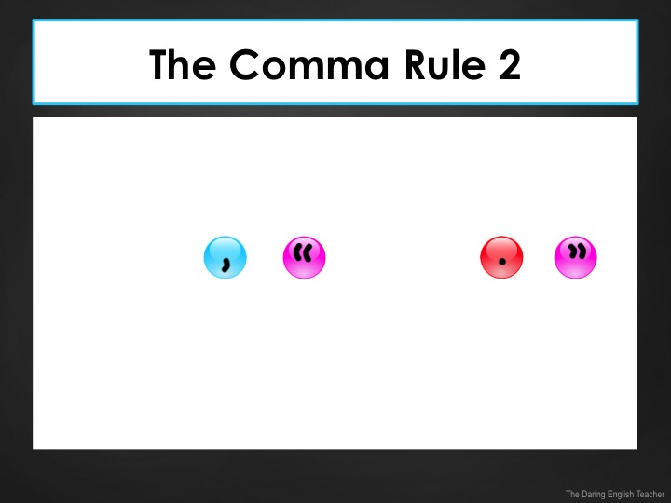
The Comma Rule 2
The comma is used to set apart dialogue from narration.
Example:
Narration + + + quote + +
Elizabeth said, “please pass the salt.”

Slide 8
The Comma Rule 2
Rule 2 Examples:
“I forgot my homework,” said James.
Amanda recalled, “I went to the water park last summer.”

Slide 9
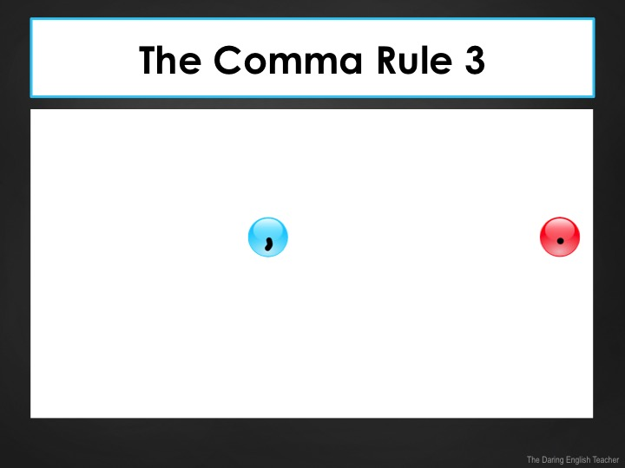
The Comma Rule 3
The comma is used to set apart dependent and independent clauses.
Example:
Dependent clause + + independent clause +
When school is over, we are going to get ice cream.

Slide 10
The Comma Rule 3
Rule 3 Examples:
Over summer break, I want to go to the pool a lot.
Before we go home, please remind me to validate the parking.

Slide 11
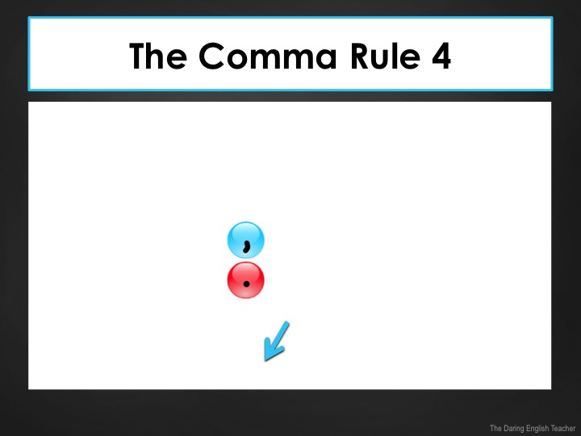
The Comma Rule 4
The comma is used to conjoin two dependent clauses when used with a coordinating conjunction.
Example:
Independent clause + + coordinating conjunction + independent clause +
I need to go to the store, for I need to buy more eggs.

Slide 12
The Comma Rule 4
Rule 4 Examples:
I want to participate in the musical, but rehearsal conflicts with soccer practice.
I am running for student body president, and I need to go home and make my campaign signs.

Slide 13
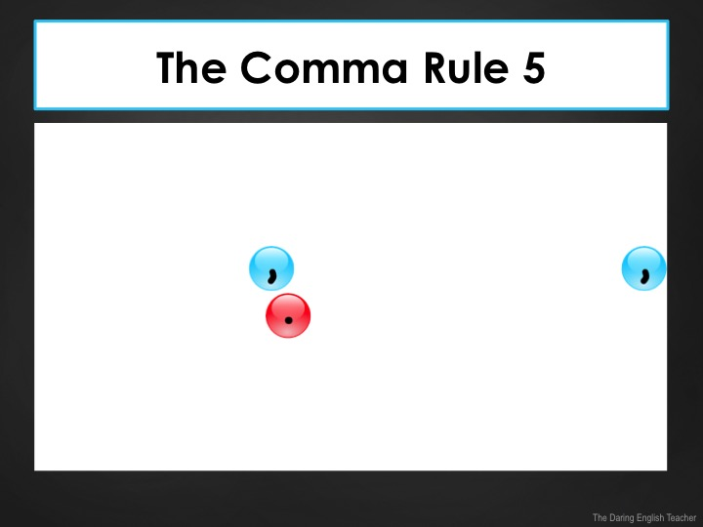
The Comma Rule 5
The comma is used to set apart parenthetical elements.
Example:
Start of sentence + + parenthetical information + + rest of sentence +
Officer Gordon, who was chasing a criminal, called dispatch for backup.
Parenthetical information is information that can be taken out of a sentence and the sentence will still make sense.

Slide 14
The Comma Rule 5
Rule 5 Examples:
My brother, the actor in our family, wants to audition for the school’s play.
The cat, after sleeping all day, decided to play with a loud bell in the middle of the night.

Slide 15
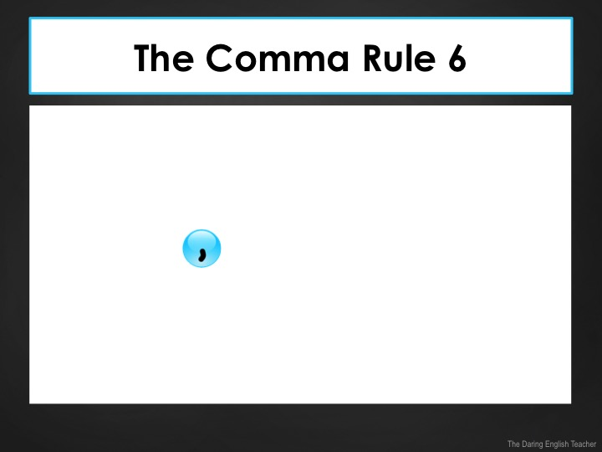
The Comma Rule 6
The comma is used to set apart coordinating adjectives.
Example:
… adjective + + adjective + noun…
The dark, lonely path looked ominous.
Coordinating adjectives are two adjectives that describe the same noun.

Slide 16
The Comma Rule 6
Rule 6 Examples:
The adorable, tiny kittens played in the box.
Her loud, obnoxious neighbor woke her up.

Slide 17
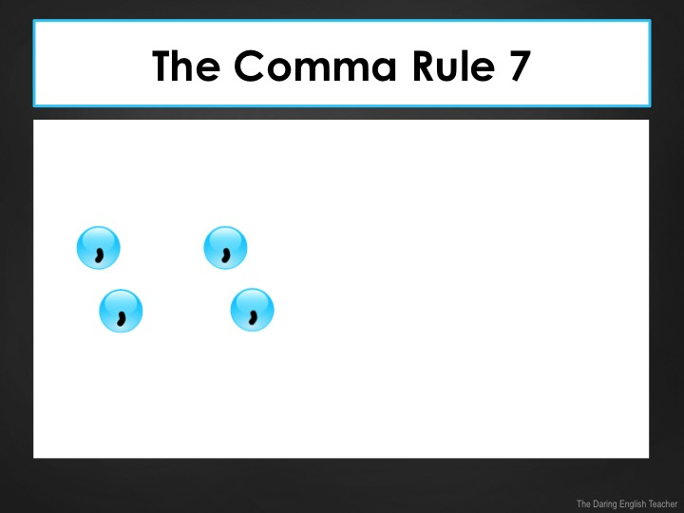
The Comma Rule 7
The comma is used in numerals and dates.
Examples:
1 + + 000 + + 000
Day + + Date + + Year
3,294
Tuesday, September 22, 2015

Slide 18
The Comma Rule 7
Rule 7 Examples:
The Declaration of Independence was signed on July 4, 1776.
The peak of Mount Everest is 29,029 feet above sea level.

Slide 19
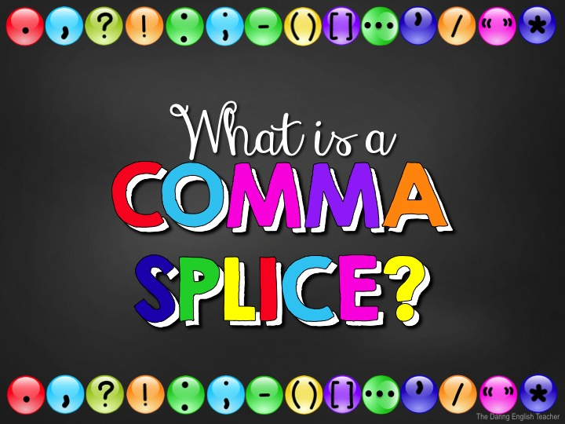

Slide 20
The Comma Splice
The comma is one of the most incorrectly used punctuation marks.
A comma splice occurs when you use a comma to conjoin two independent clauses.

Slide 21
The Comma Splice
An independent clause is a complete sentence –it can stand on its own.
Examples: Our team won.
We are advancing to finals.
A comma splice example
Our team won, we are advancing to finals.
Both of these sentences are independent clauses.
The comma is not strong enough to support both independent clauses.

Slide 22
The Comma Splice
Incorrect | Our team won, we are advancing to finals.
Correct | Our team won. We are advancing to finals.
Correct | Our team won; we are advancing to finals.
Correct | Our team won, so we are advancing to finals.
Use a period
Use a semicolon
Add a coordinating conjunction

Slide 23
The Comma Splice
Does this sentence contain a comma splice?
He stayed out, I went home.
YES!
Don’t let the length of a sentence fool you!

Slide 24
The Comma Splice
Incorrect | He stayed out, I went home.
Correct | He stayed out. I went home.
Correct | He stayed out; I went home.
Correct | He stayed out, but I went home.
Use a period
Use a semicolon
Add a coordinating conjunction

Slide 25
The Comma Splice
Does this sentence contain a comma splice?
Sitting outside, he began to sweat.
NO!
Sitting outside is not a complete sentence. It is a dependent clause. !

Slide 26
The Comma Splice
Correct | Sitting outside, he began to sweat.
Incorrect | Sitting outside. He began to sweat.
Incorrect | Sitting outside; he began to sweat.
Incorrect | Sitting outside, so he began to sweat.

